Slide 1
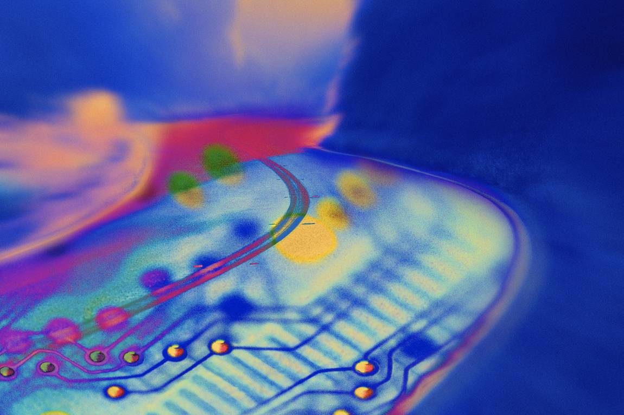
IT Essentials (CompTIA A+) Ch. 6
Basic Input Output System (BIOS)

Slide 2
Overview
In this chapter, you will learn how to:
Explain the function of BIOS
Distinguish among various CMOS setup utility options
Describe option ROM and device drivers
Troubleshoot the power-on self test (POST)
Maintain BIOS and CMOS properly
Notes:
2

Slide 3
We Need to Talk
Two functions are necessary for devices to work.
The CPU must have a way to talk to devices.
Devices must have a way to send data to and receive data from the CPU.
The fix gives extra functionality to the MCC using it to connect the CPU to all the devices.
Called the Northbridge
Separate Southbridge chip also handles interconnectivity work.
Notes:
3
A group of disjointed parts is not very useful. They need to be able to talk to each other to be useful.

Slide 4
Northbridge vs. Southbridge
Together, Northbridge and Southbridge are referred to as the chipset.
The Northbridge connects the CPU to video card and RAM.
The Southbridge deals mainly with lower speed devices such as USB controller and hard drive controllers.
The chipset extends the data bus to touch all the devices.
It also extends the address bus.
Notes:
Note: Modern processors include the functions of the Northbridge directly on the CPU. The Southbridge is now called the Input/Output Controller Hub (ICH) in new Intel systems and the Fusion Controller Hub (FCH) in new AMD systems.

Slide 5
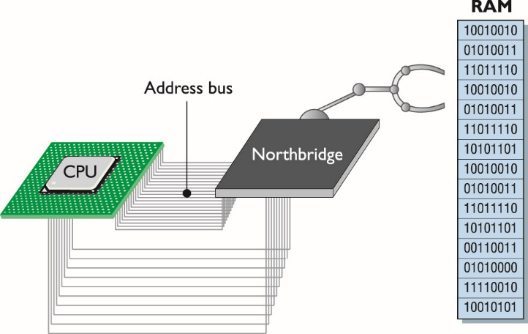
Northbridge vs. Southbridge
Figure 6.1 Meet the Northbridge
Notes:
The MCC isn’t just the memory controller anymore, so let’s now call it the Northbridge because it acts as the primary bridge between the CPU and the rest of the computer (see Figure 6.1).

Slide 6
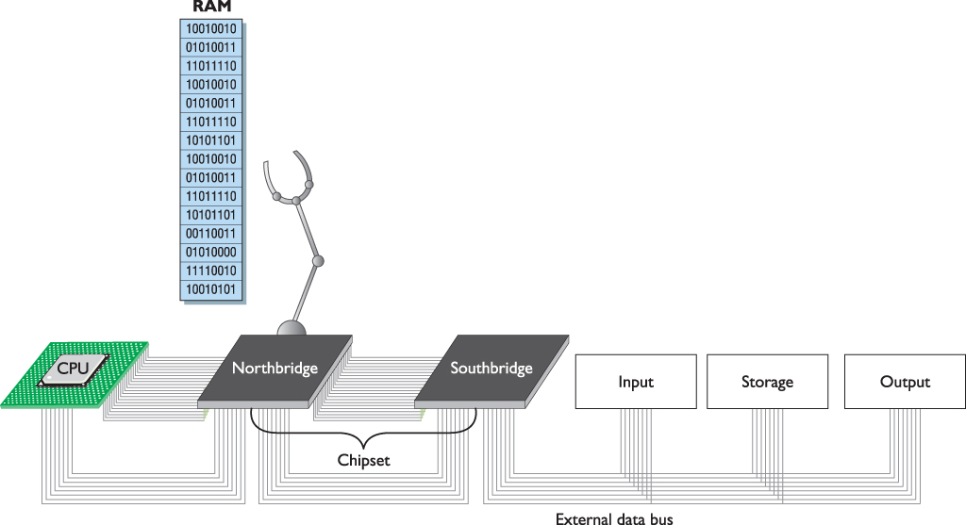
Northbridge vs. Southbridge
Figure 6.2 The chipset extending the data bus
Notes:
The chipset extends the data bus to every device on the PC. The CPU uses the data bus to move data to and from all of the devices of the PC. Data constantly flows on the external data bus among the CPU, chipset, RAM, and other devices on the PC (see Figure 6.2).

Slide 7
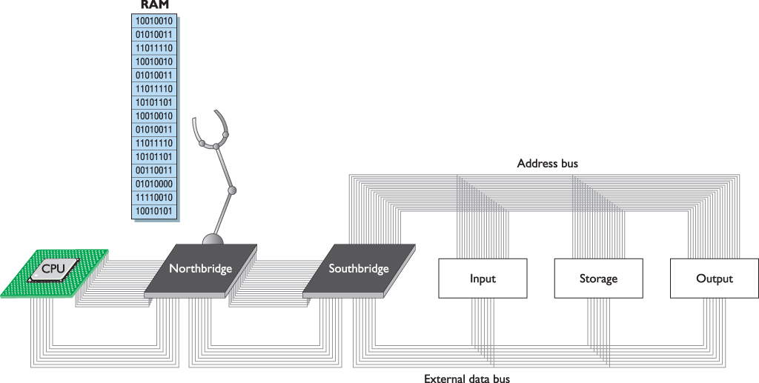
Northbridge vs. Southbridge
Figure 6.3 Every device in your computer connects to the address bus.
Notes:
The first use for the address bus, as you know, is for the CPU to tell the chipset to send or store data in memory and to tell the chipset which section of memory to access or use. Just as with the external data bus, the chipset extends the address bus to all of the devices (see Figure 6.3). That way, the CPU can use the address bus to send commands to devices, just as it sends commands to the chipset.

Slide 8
Talking to the Keyboard
How does the CPU recognize when a key is pressed?
A scanning chip in the keyboard notices which key has been pressed and sends a coded pattern of ones and zeros to the keyboard controller.
The keyboard controller stores the scan code in its register.
When the CPU addresses the keyboard controller, the keyboard controller places the data onto the external data bus so that the CPU can read it.
Notes:
But how does the CPU tell the 8042 to put the contents of its register on the data bus? The CPU uses the keyboard controller’s codebook!

Slide 9
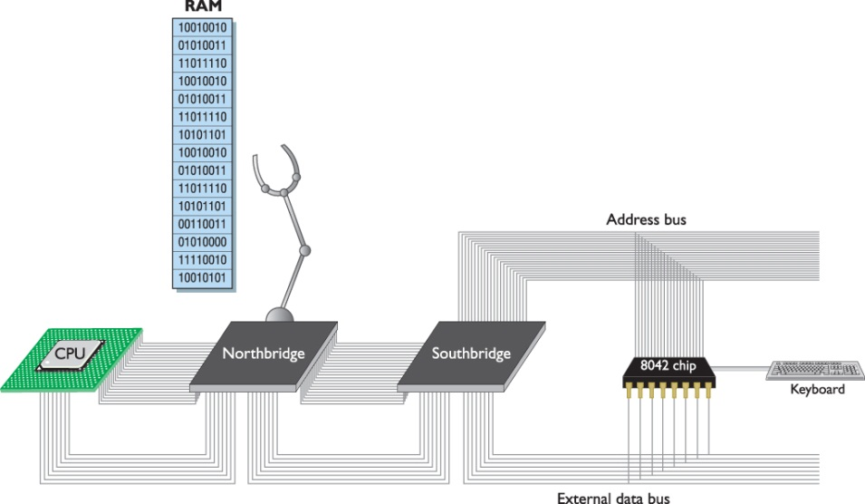
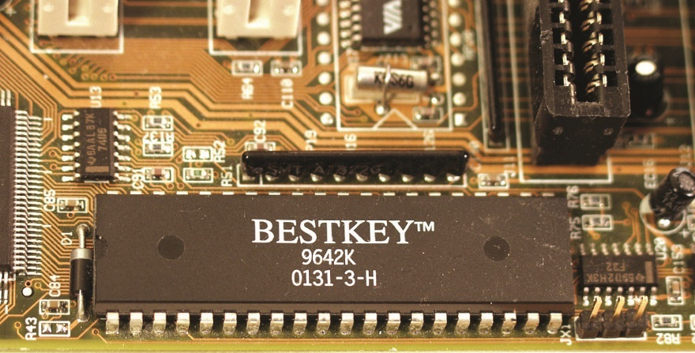
Talking to the Keyboard
Figure 6.4 A keyboard chip on a Pentium motherboard
Figure 6.5 Electronic view of the keyboard controller
Notes:
The keyboard controller was one of the last single-function chips to be absorbed into the chipset. For many years—in fact, well into the Pentium III/ Early Athlon era—most motherboards had separate keyboard controller chips. Figure 6.4 shows a typical keyboard controller from those days. Electronically, it looked like Figure 6.5. Even though the model numbers changed over the years, you’ll still hear techs refer to the keyboard controller as the 8042, after the original keyboard controller chip.

Slide 10
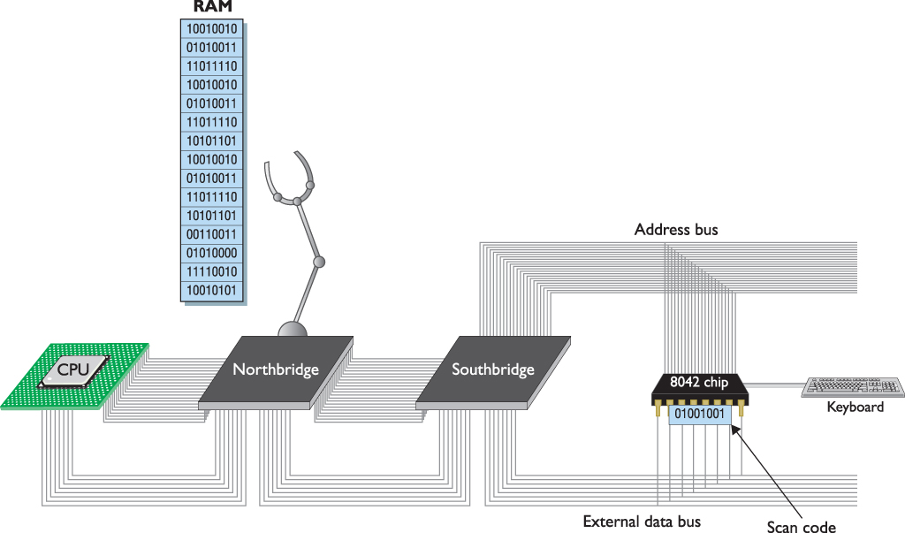
Talking to the Keyboard
Figure 6.6 Scan code stored in keyboard controller’s register
Notes:
Every time you press a key on your keyboard, a scanning chip in the keyboard notices which key you pressed. Then the scanner sends a coded pattern of ones and zeros—called the scan code—to the keyboard controller. Every key on your keyboard has a unique scan code. The keyboard controller stores the scan code in its own register. Does it surprise you that the lowly keyboard controller has a register similar to a CPU? Lots of chips have registers—not just CPUs (see Figure 6.6).

Slide 11
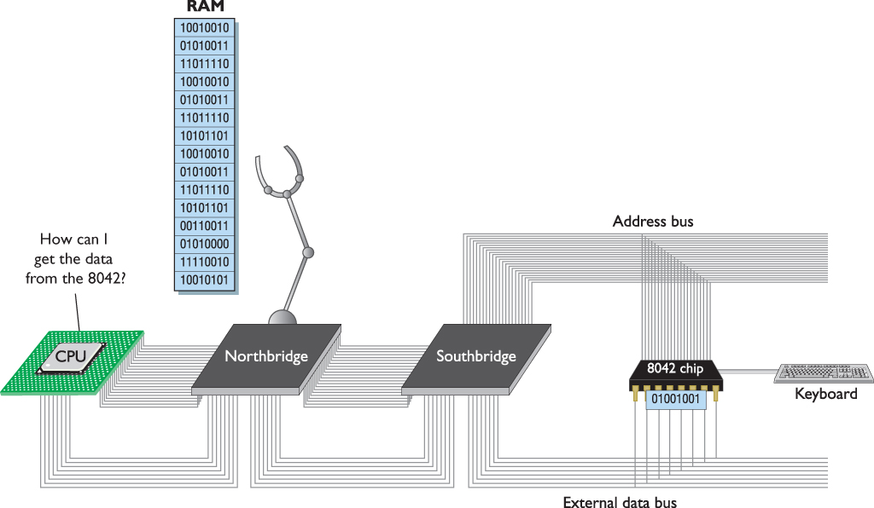
Talking to the Keyboard
Figure 6.7 The CPU ponders the age-old dilemma of how to get the 8042 to cough up its data.
Notes:
How does the CPU get the scan code out of the keyboard controller (see Figure 6.7)? While we’re at it, how does the CPU tell the keyboard to change the typematic buffer rate (when you hold down a key and the letter repeats) or to turn the number lock LED on and off, to mention just a few other jobs the keyboard needs to do for the system? The point is that the keyboard controller must be able to respond to multiple commands, not just one.

Slide 12
Basic Input/Output Services
Basic support programming to tell the CPU how to communicate with devices is known as BIOS.
Programs called services or device drivers
Must be available without the operating system
Stored on the motherboard in permanent storage called Read-Only Memory (ROM)

Slide 13
ROM
ROM chips are nonvolatile, i.e., stored content is not lost when the computer is turned off.
ROM chips are read-only meaning that once a program is stored on one, it can’t be changed.
Flash ROM is used on modern motherboards.
Can be changed by process of flashing the ROM
System ROM chip contains code that allows the CPU to talk to basic hardware devices.
This collection of programs is called system BIOS.
Techs call programs on ROM, firmware.

Slide 14
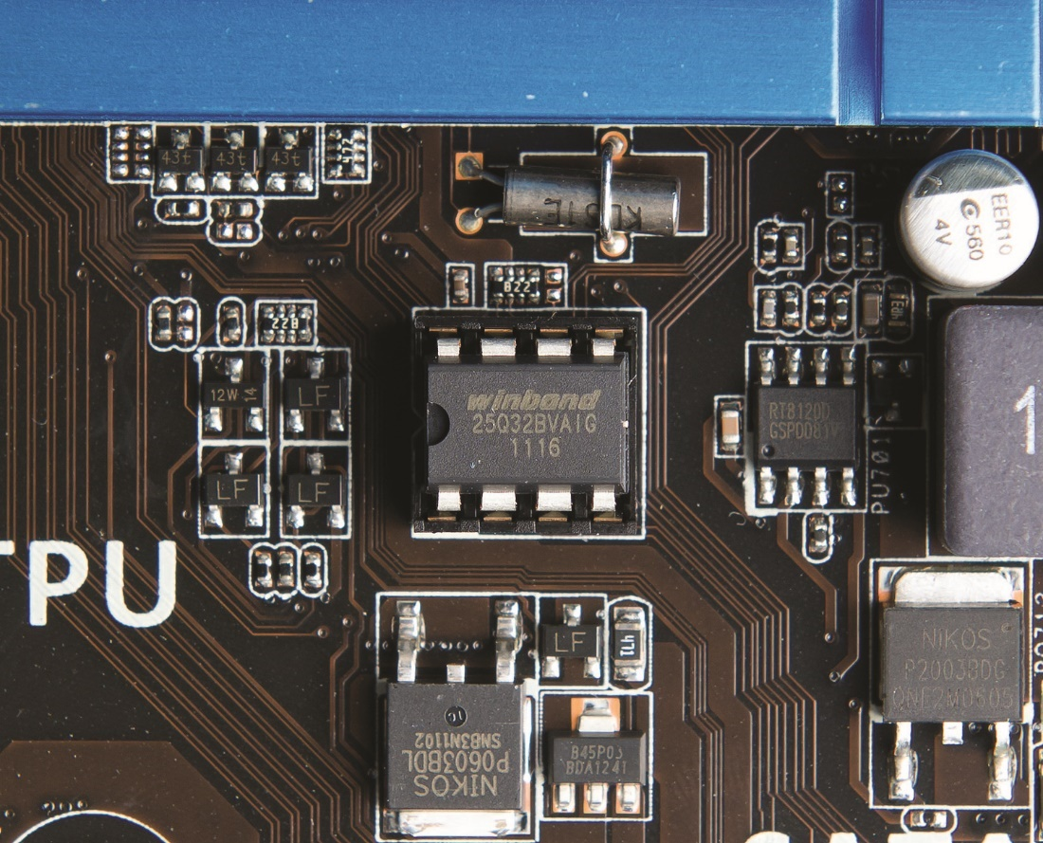
ROM
Figure 6.8 Typical flash ROM
Notes:
Modern motherboards use a type of ROM called flash ROM that differs from traditional ROM in that you can update and change the contents through a very specific process called “flashing the ROM,” covered later in this chapter. Figure 6.8 shows a typical flash ROM chip on a motherboard.

Slide 15
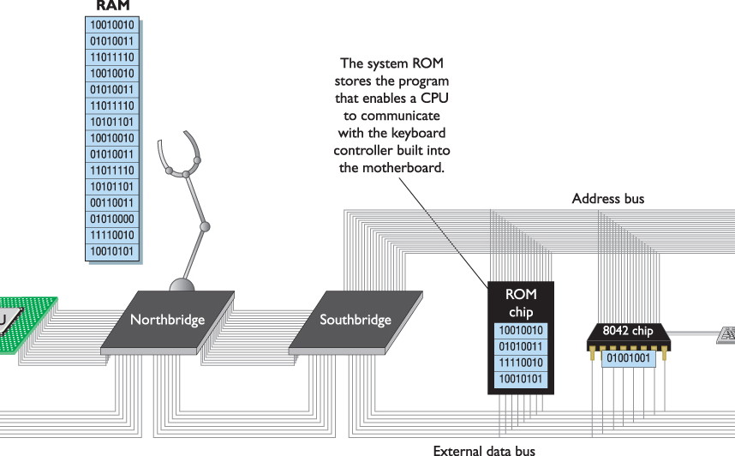
ROM
Figure 6.9 Function of the flash ROM chip
Notes:
Every motherboard has a flash ROM chip, called the system ROM chip because it contains code that enables your CPU to talk to the basic hardware of your PC (see Figure 6.9).

Slide 16
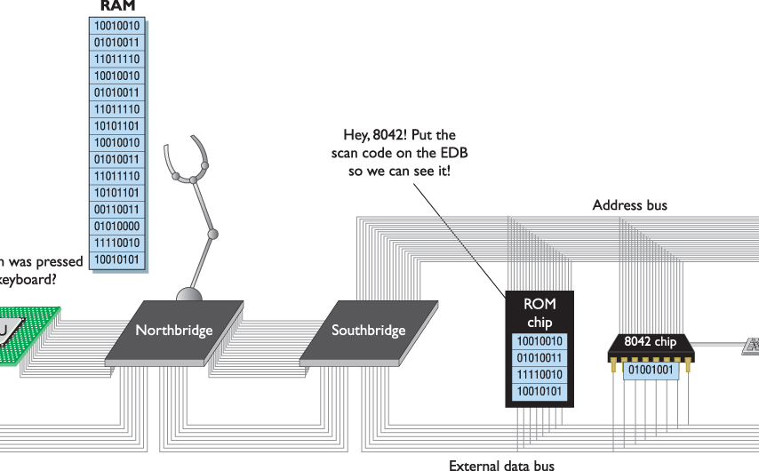
ROM
Figure 6.10 CPU running BIOS service
Notes:
The hundreds of little programs stored on the system ROM chip on the motherboard are called, collectively, the system BIOS (see Figure 6.10). Techs call programs stored on ROM chips of any sort firmware.

Slide 18
System BIOS Support
System BIOS supports hardware that never changes.
Keyboard
PC speaker
System BIOS supports hardware that might change from time to time.
RAM
Hard disk

Slide 19
UEFI
Unified Extensible Firmware Interface (UEFI)
Modern BIOS
Replaces 16-bit BIOS
Advantages of UEFI
Supports file systems that enable booting to drives larger than 2.2 TB
Supports 32-bit or 64-bit booting
Handles all boot-loading duties
Not dependent on x86 firmware

Slide 20
CMOS
CMOS is a separate chip from the ROM BIOS, most often now part of the Southbridge.
CMOS is volatile, kept alive by a battery.
Acts as a clock and keeps the date and time
CMOS stores data to complete the programs needed to talk to changeable hardware.
Must update the CMOS if you change hardware
Most CMOS chips store about 64 KB of data.
PC only needs about 128 bytes to store all of the needed information on the changeable hardware.

Slide 21
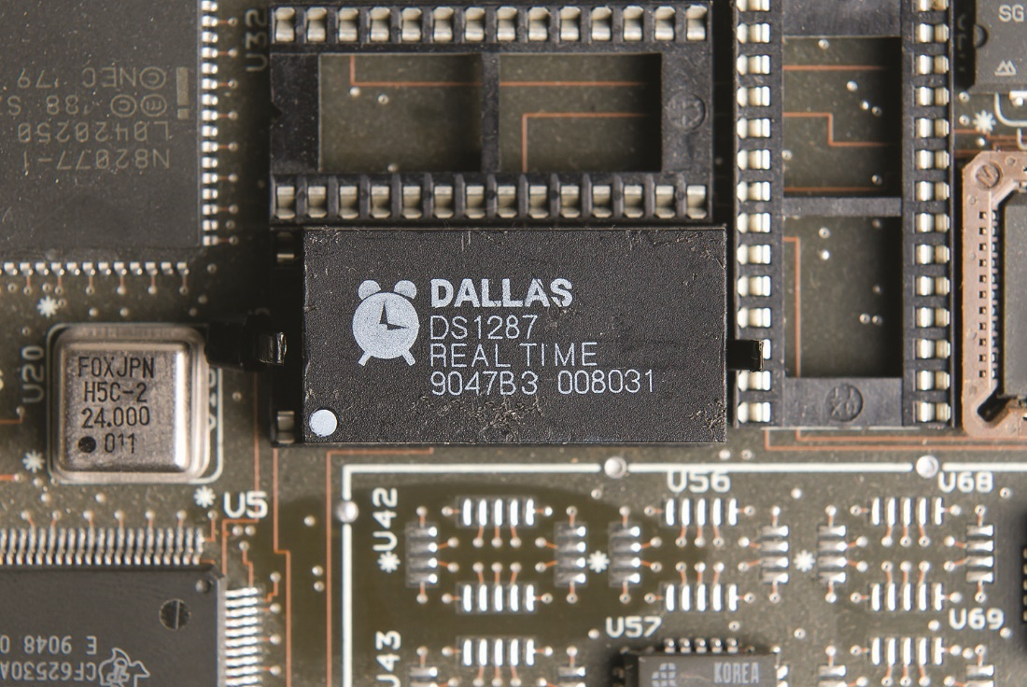
CMOS
Figure 6.11 Old-style CMOS
Notes:
Years ago, CMOS was a separate chip on the motherboard, as shown in Figure 6.11. Today, the CMOS is almost always built into the Southbridge.

Slide 22
Modify CMOS
CMOS setup program (or system setup utility) is built into the system ROM BIOS.
Enables you to access and modify CMOS data
Two major BIOS manufacturers:
American Megatrends
Phoenix Technologies (bought Award Software)
CMOS setup can be accessed:
Traditionally at boot
Via the Settings charm on the Charm bar (Windows 8/8.1)

Slide 23
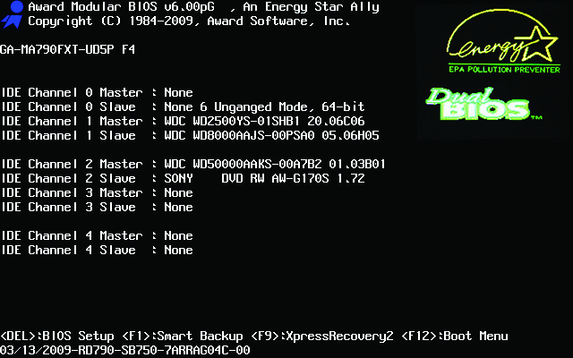
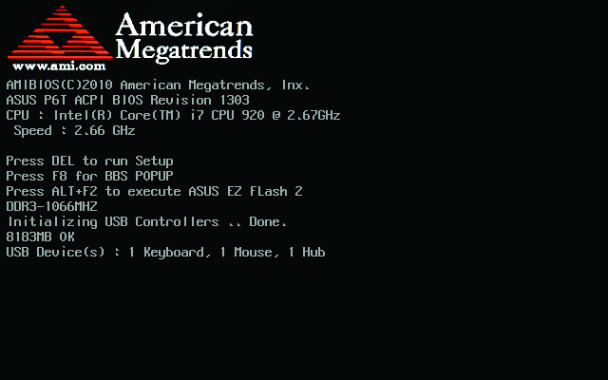
Modify CMOS
Figure 6.12 AMIBIOS information
Figure 6.13 Award/Phoenix BIOS information
Notes:
Every PC ships with a program built into the system ROM called the CMOS setup program or the system setup utility that enables you to access and modify CMOS data. When you fire up your computer in the morning, the first thing you likely see is the BIOS information. It might look like the example shown in Figure 6.12 or perhaps like the example shown in Figure 6.13.

Slide 24
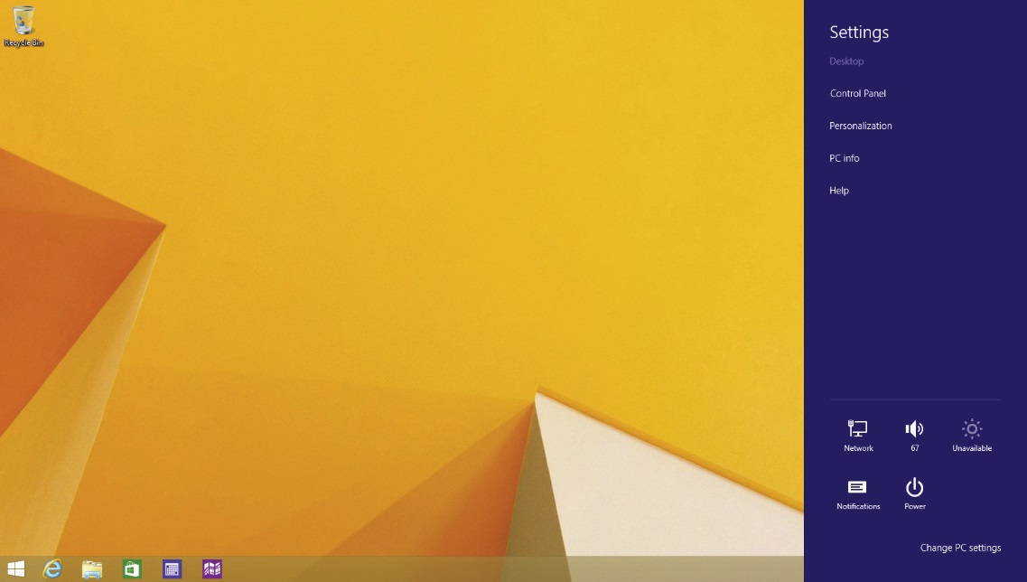
Accessing CMOS
In a UEFI-based system running Windows 8/8.1, access CMOS from the Settings charm on the Charms bar.
Figure 6.14 Settings charm options

Slide 25
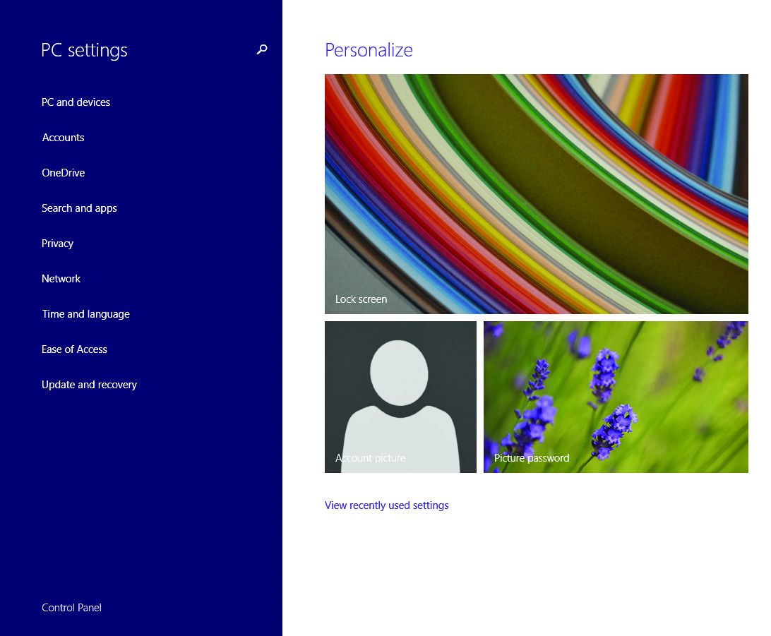
Accessing CMOS
Click the option to change PC settings.
Click the update and recovery link.
Select the recovery link to see desired options.
Figure 6.15 PC settings app

Slide 26
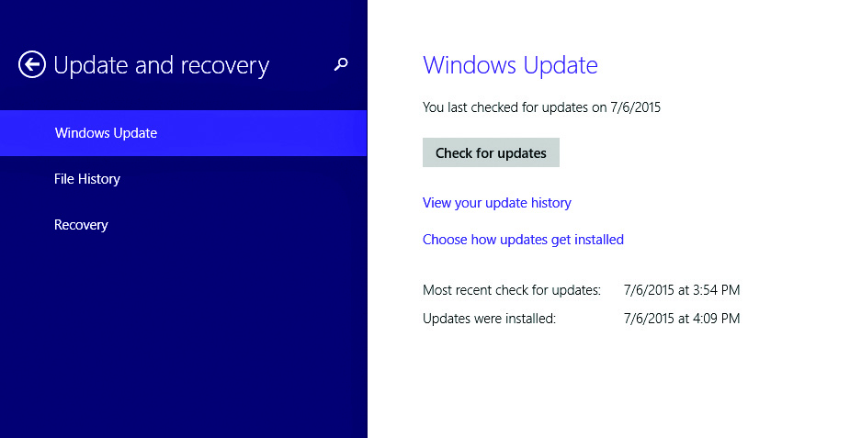
Accessing CMOS
Figure 6.16 Update and recovery screen

Slide 27
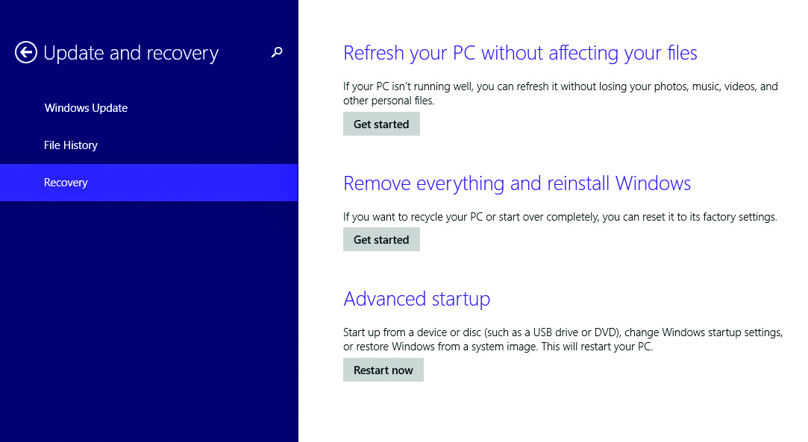
Accessing CMOS
Figure 6.17 Recovery options on the Update and recovery screen

Slide 28
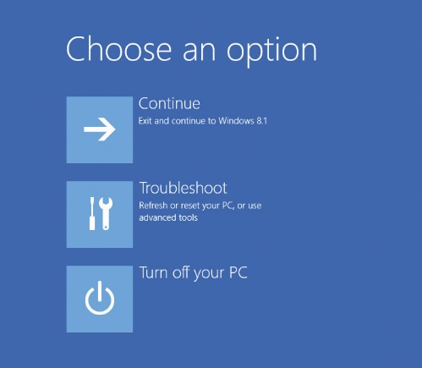
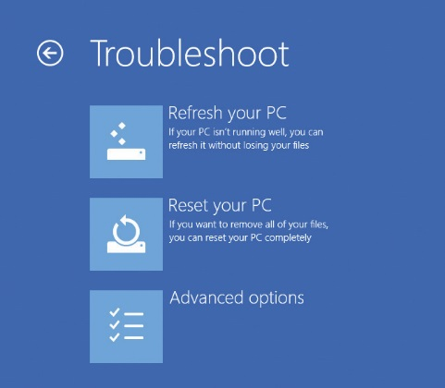
Accessing CMOS
Under advanced startup, click Restart Now.
The screen, Choose an option, displays.
Click Troubleshoot.
Click Advanced options.
Figure 6.18 Choose an option screen
Figure 6.19 Troubleshoot options

Slide 29
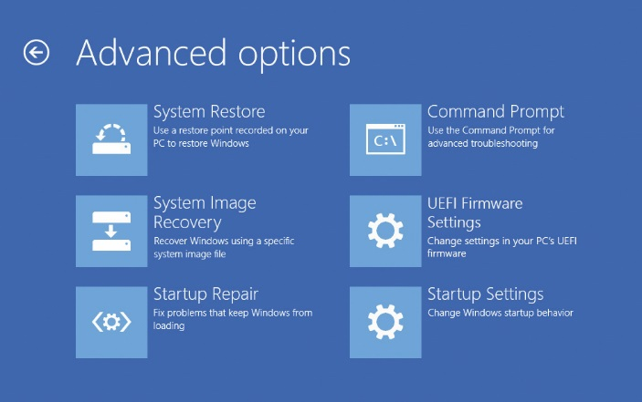
Accessing CMOS
Figure 6.20 UEFI firmware settings option on the Advanced options screen

Slide 30
Accessing CMOS
Click the UEFI Firmware Settings option.
System reboots and goes into system setup utility.
Note: It’s a lot faster to reboot and access the CMOS setup manually.

Slide 31
Accessing CMOS
Key sequences needed are usually displayed on the screen as computer boots.
Example: “Press DEL to run Setup”
If message does not show, try the following or check the manufacturer’s Web site.
DELETE or ESC
CTRL-S
F1 or F2
CTRL-ALT-ESC
CTRL-ALT-INS
CTRL-ALT-ENTER

Slide 32
CMOS Setup
There are two styles of utilities:
Graphical CMOS setup utilities
Classic text-only CMOS setup utilities

Slide 33
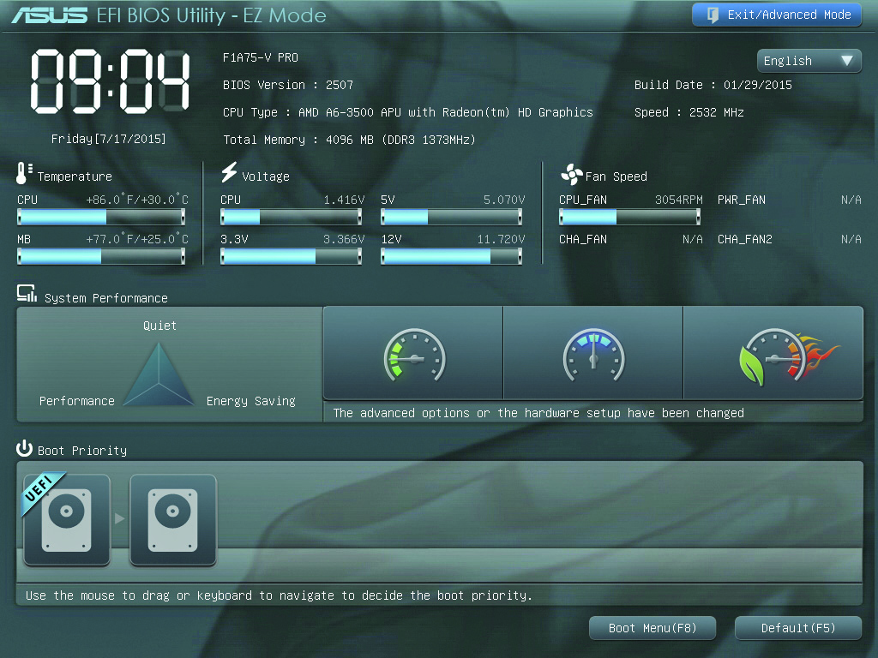
Graphical UEFI Setup Utility
Figure 6.21 ASUS EFI Bios utility setup screen in EZ mode

Slide 34
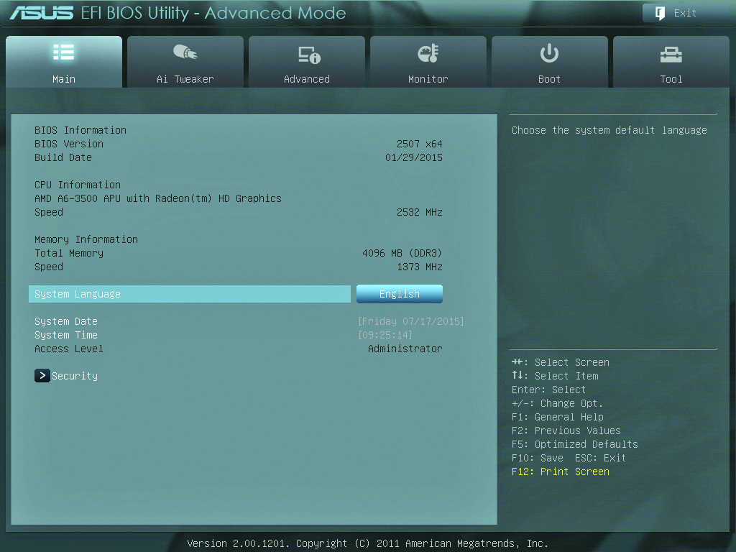
Graphical UEFI Setup Utility
Figure 6.22 Main tab

Slide 35
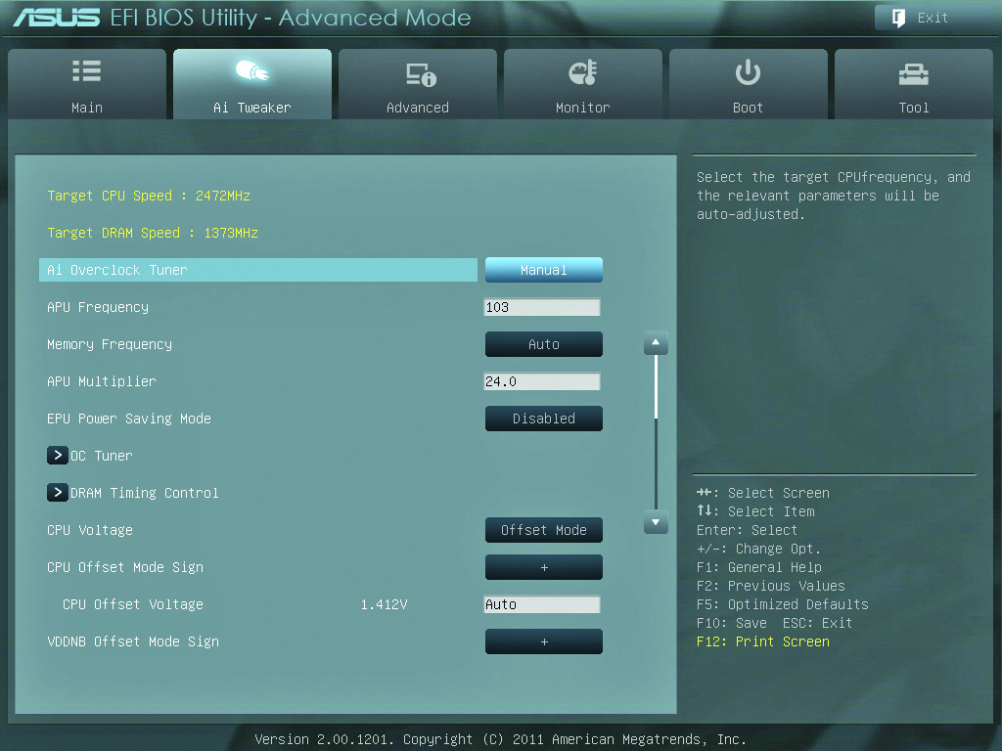
Graphical UEFI Setup Utility
Figure 6.23 Ai Tweaker tab

Slide 36
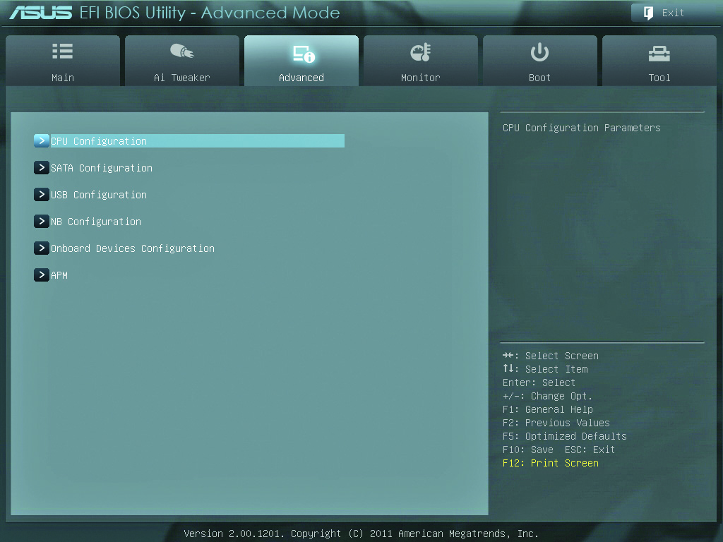
Graphical UEFI Setup Utility
Figure 6.24 Advanced tab

Slide 37
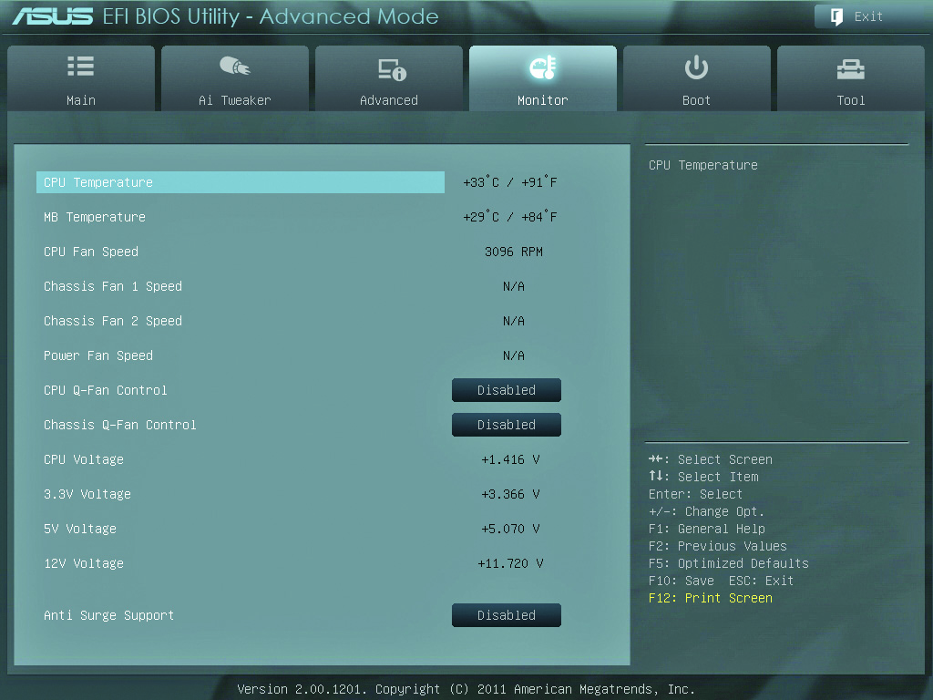
Graphical UEFI Setup Utility
Figure 6.25 Monitor tab

Slide 38
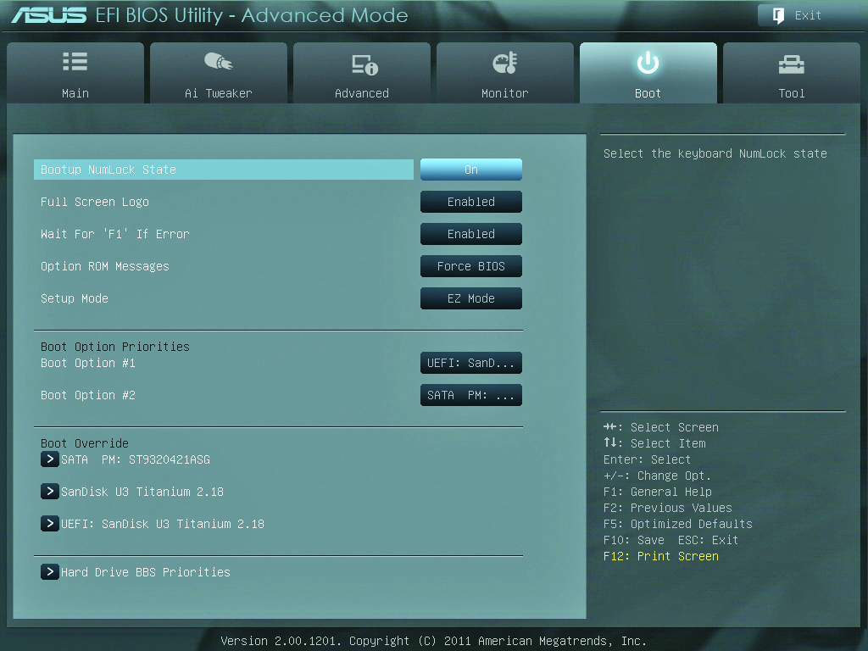
Graphical UEFI Setup Utility
Figure 6.26 Boot tab

Slide 39
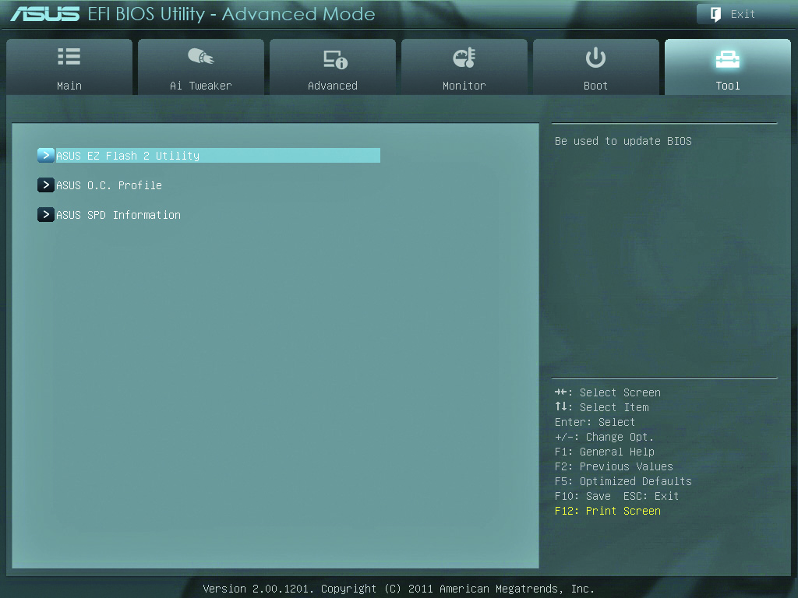
Graphical UEFI Setup Utility
Figure 6.27 Tool tab

Slide 40
Text-Based UEFI Setup Utility
Information tab gives details about CPU and RAM.
Configuration tab:
Allows configuration of built-in devices
Can enable or disable virtualization support
Security tab includes additional options.
Secure boot feature requires properly signed software during boot.
Boot tab allows support for booting to a USB device.

Slide 41
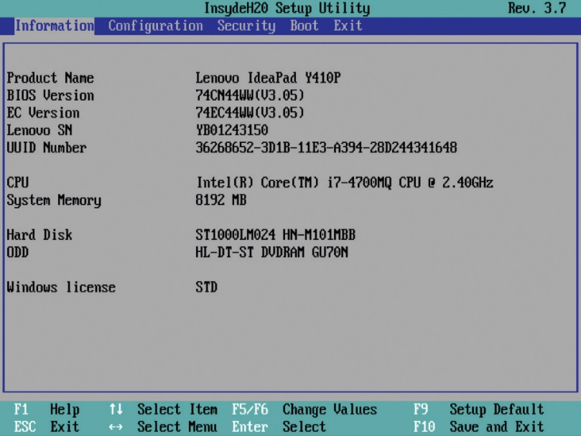
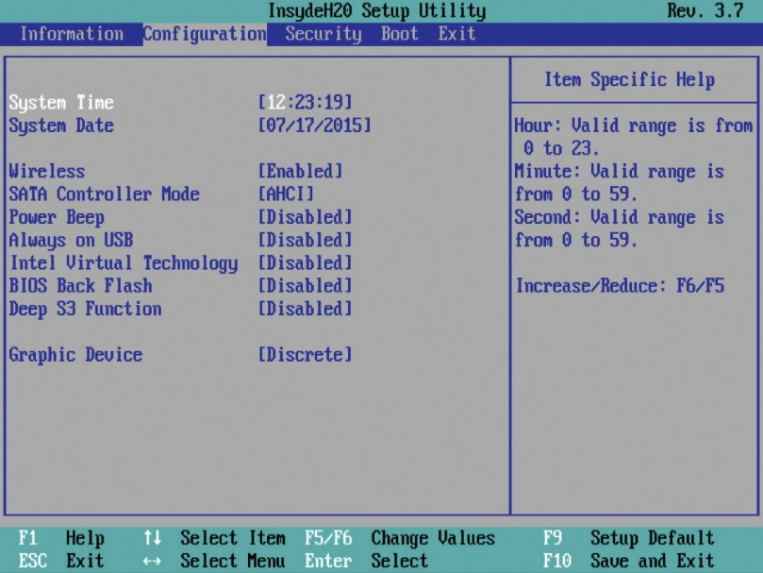
Text-Based UEFI Setup Utility
Figure 6.28 Information tab
Figure 6.29 Configuration tab

Slide 42
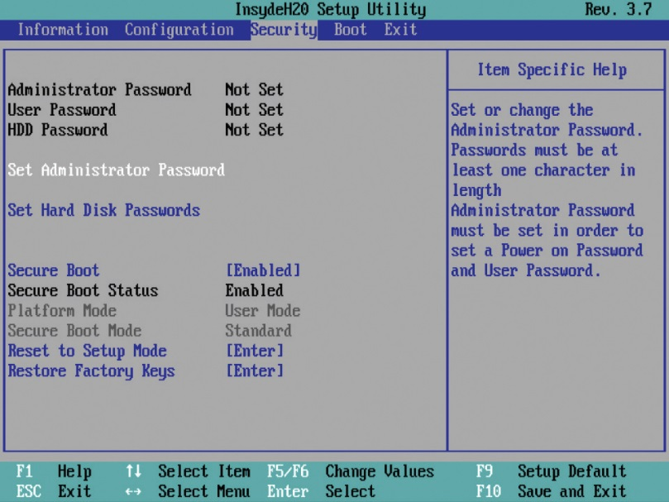
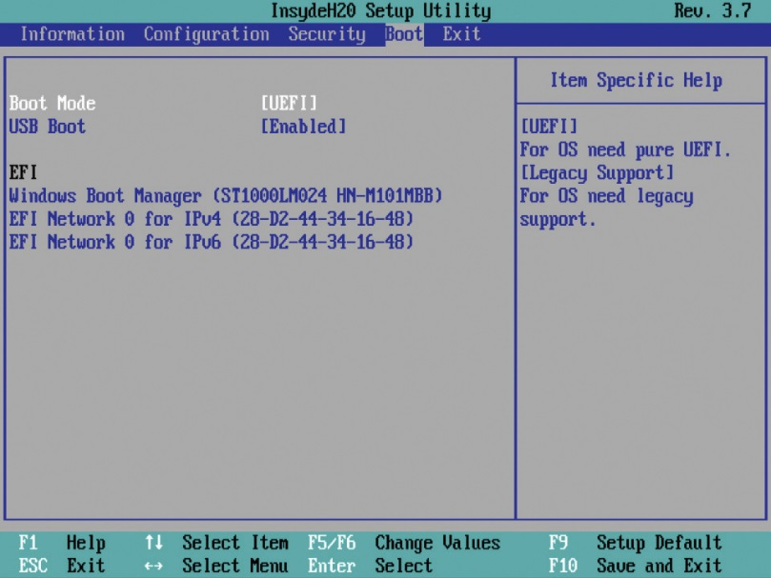
Text-Based UEFI Setup Utility
Figure 6.30 Security tab
Figure 6.31 Boot tab

Slide 43
Text-Based UEFI Setup Utility
Other BIOS security options
Chassis intrusion detection/notification
DriveLock
LoJack
Trusted Platform Module (TPM)
Commonly used for hard disk encryption
System utility save options
Save and Exit
Exit Discarding Saving

Slide 44
Now You Try it
Reboot your laptop, and press the correct key to enter the BIOS setup utility.
Is your time and date correct? Why?
What hardware information is available?
What hardware/peripherals can be enabled and disabled?
Can you alter your video hardware configuration? What settings?
Are any overclocking settings available? Where?
What security options are available?
What options do you have to configure the boot order? (can you see what boot devices are available?)

Slide 46
ROM and Device Drivers
Ways to add programming other than on the BIOS—Bring Your Own BIOS (BYOB):
Option ROM
Device drivers
An option ROM chip provides its own BIOS on an expansion card.
Device drivers are a software version of BYOB.
Stored on hard drive and loaded into RAM at boot
Comes with item purchase on an installation disc.
Registry stores device driver information.

Slide 47
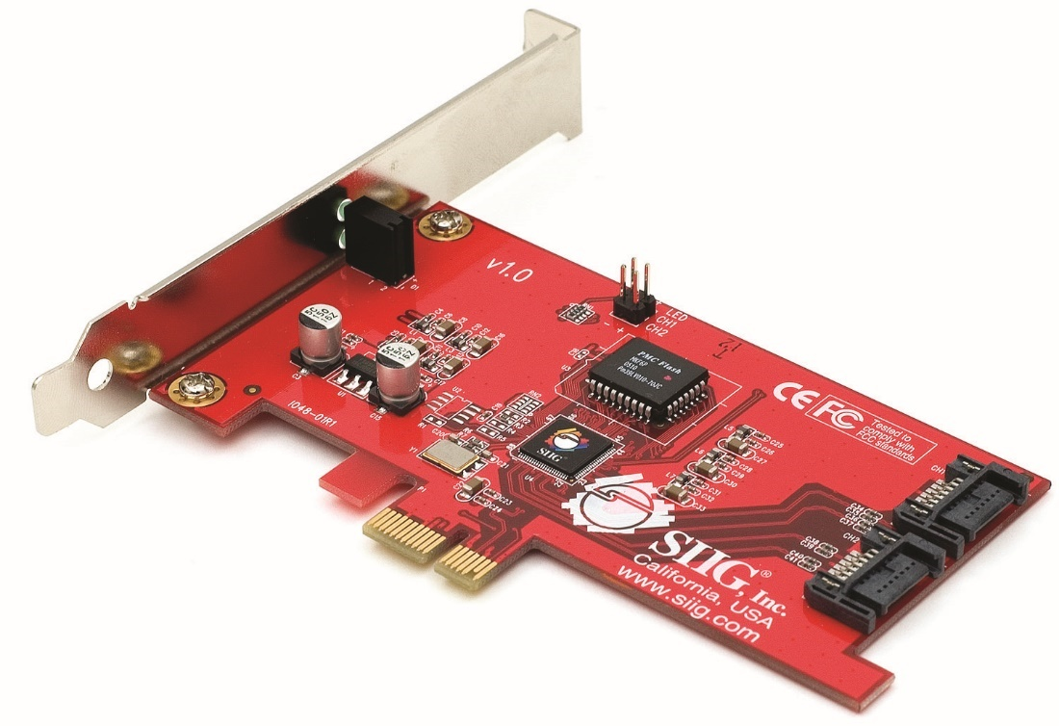
Option ROM
Figure 6.33 Option ROM on expansion card
Notes:
The first way to BYOB is to put the BIOS on the hardware device itself. Look at the card displayed in Figure 6.33. This is a serial ATA RAID hard drive controller—basically just a card that lets you add more hard drives to a PC. The chip in the center with the wires coming out the sides is a flash ROM that stores BIOS for the card. The system BIOS does not have a clue about how to talk to this card, but that’s okay, because this card brings its own BIOS on what’s called an option ROM chip.

Slide 48
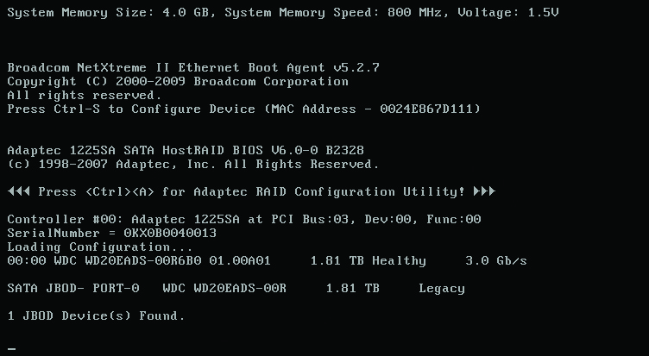
Option ROM
Figure 6.34 Option ROM at boot
Notes:
Most BIOS that come on option ROMs tell you that they exist by displaying information when you boot the system. Figure 6.34 shows a typical example of an option ROM advertising itself.
In the early days of the PC, you could find all sorts of devices with BIOS on option ROMs. Today, option ROMs have mostly been replaced by more flexible software methods (more on device driver software in the next section), with one major exception: video cards. Every video card made today contains its own BIOS. Option ROMs work well but are hard to upgrade. For this reason, most hardware relies on software for BYOB.

Slide 49
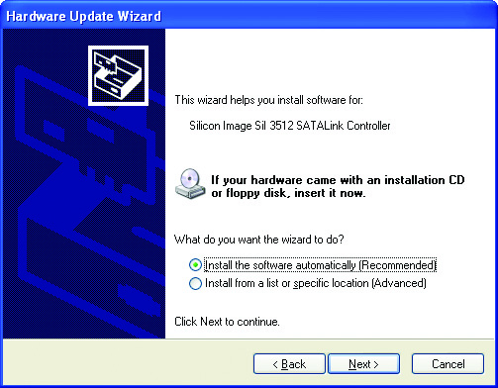
BIOS, BIOS, Everywhere!
Every piece of hardware must have a program that allows the CPU to communicate with it.
The program may be on motherboard ROM, ROM on a card, or software loaded into RAM at boot.
Figure 6.35 Windows XP asking for the installation disc

Slide 51
Power-On Self Test (POST)
Upon boot, the ROM initiates the power-on self test (POST) process.
The POST routine sends out a message to all devices to initiate self-tests.
All standard devices run their own built-in diagnostic.
If a component fails self-diagnostics, the POST process sends an error message to the user.
Beep codes and text messages

Slide 52
BIOS Fault Codes
Modern PC beep code for bad or missing video
One long beep followed by two or three short beeps
For missing or faulty RAM
Single beep that repeats indefinitely
Successful completion of the POST
One or two short beeps

Slide 53
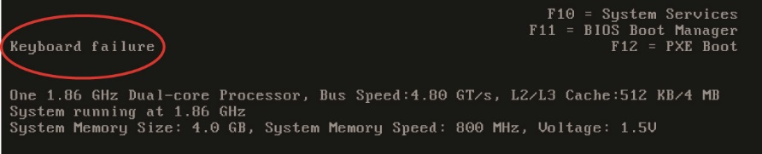
Text Errors
Once the video is determined to be good, errors can be displayed.
Errors are usually displayed in clear text, though they can sometimes be rather cryptic.
Figure 6.36 POST text error messages
Notes:
After the video has tested okay, any POST errors display on the screen as text errors. If you get a text error, the problem is usually, but not always, self-explanatory (see Figure 6.36). Text errors are far more useful than beep codes, because you can simply read the screen to determine the bad device.

Slide 54
POST Cards
POST cards snap into an expansion slot.
Used to monitor the POST and identify which piece of hardware is causing startup issues
A small, two-character light-emitting diode (LED) readout on the card indicates which device the POST is currently testing.

Slide 55
POST Cards
In the past, POST cards were essential tools for techs.
Today they are only used on a “dead” PC to determine at which level it’s dead.
If the POST card shows no reading, the problem is before the POST and must be related to power, the CPU, RAM, or the motherboard.

Slide 56
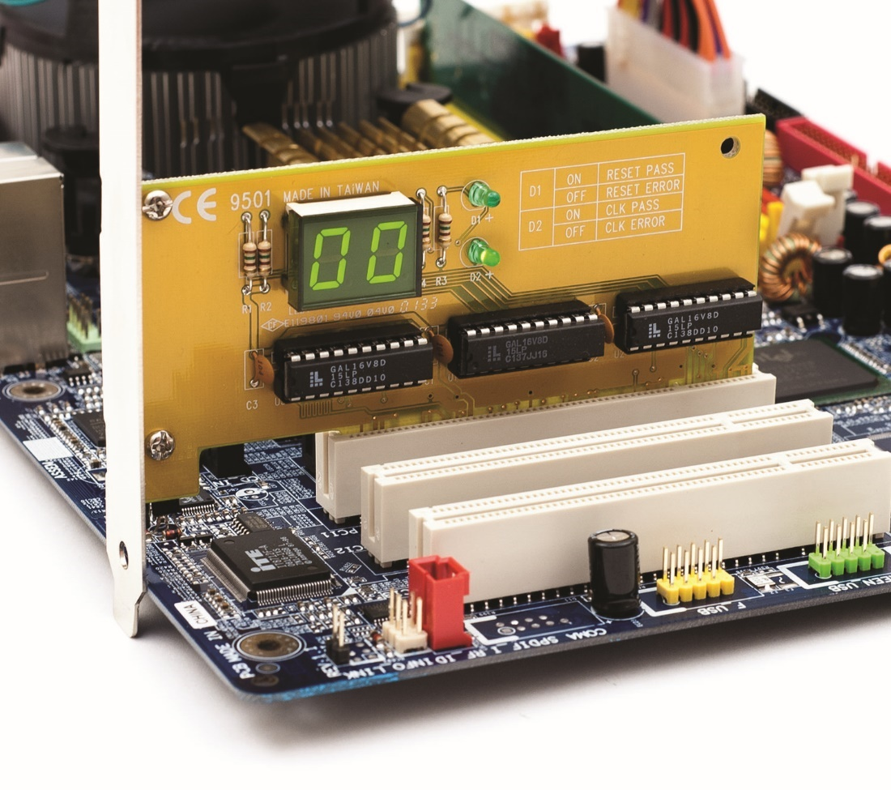
POST Cards
Figure 6.37 POST card in action
Notes:
A small, two-character light-emitting diode (LED) readout on the card indicates which device the POST is currently testing (see Figure 6.37).

Slide 57
The Boot Process
The power supply checks for proper voltage.
If the proper voltage is found, the power supply sends a signal through the power good wire.
This awakens the CPU, which in turn sends a built-in memory address, which is the first line of the POST program on the system ROM.
The ROM begins the POST routines.

Slide 58
The Boot Process
Older BIOS environment process
Once the POST is passed, the ROM begins the boot process (the bootstrap loader) by looking for an operating system according to the CMOS settings.
Boot sequence tells which devices to check for an operating system (bootable disk or system disk).
UEFI system process
POST hands control to the boot manager, which checks the boot configuration, and then loads the operating system boot loader directly.

Slide 59
The Boot Process
Some BIOS have feature for preboot execution environment (PXE).
Enables booting a PC without local storage
Retrieves OS from server or over a network

Slide 60
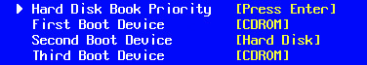
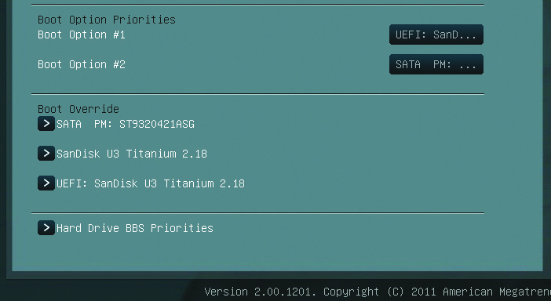
The Boot Process
Figure 6.38 CMOS boot sequence
Figure 6.39 UEFI Boot Mode with Boot Manager options displayed
Notes:
Your PC’s CMOS setup utility has an option that you configure to tell the bootstrap loader which devices to check for an operating system and in which order (see Figure 6.38). In UEFI systems, there’s no need for scanning for a boot sector or any of that. UEFI firmware stores the boot manager and boot configuration. (See Figure 6.39)

Slide 61
BIOS and CMOS
Default/optimized settings
CMOS setup utility has reset options.
Load Default Settings
OS Optimized Defaults
Clearing CMOS
CMOS Clear sets CMOS back to factory defaults.
Turn off and unplug the computer.
Locate the CMOS clear wires.
Move the shunt from wires 1 and 2 to wires 2 and 3, then wait ten seconds and move back to original position.

Slide 62
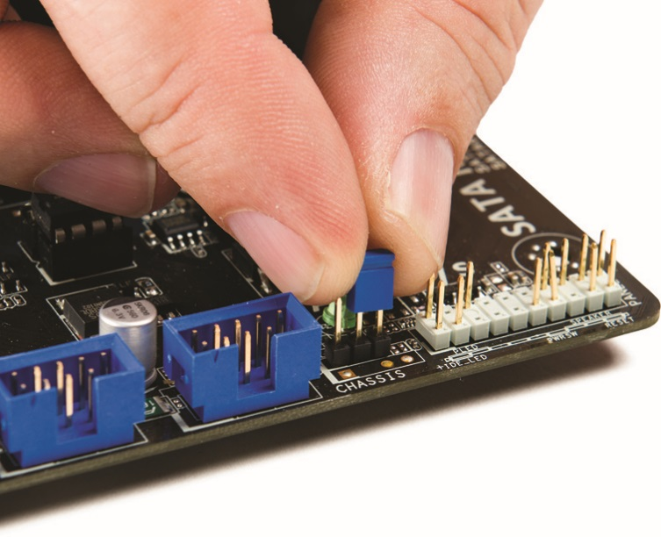
Clearing CMOS
Figure 6.42 Changing shunt location to clear CMOS settings

Slide 63
Clearing CMOS
If motherboard does not have CMOS clear jumpers:
Power down the system and unplug.
Remove and replace the coin battery.

Slide 64
Losing CMOS settings
CMOS needs continual trickle charge, typically provided by a coin battery, to retain data.
Battery also keeps track of date and time while PC is off.
Common errors with lost CMOS:
CMOS configuration mismatch
CMOS date/time not set
BIOS time and settings reset
No boot device available
CMOS battery state low

Slide 65
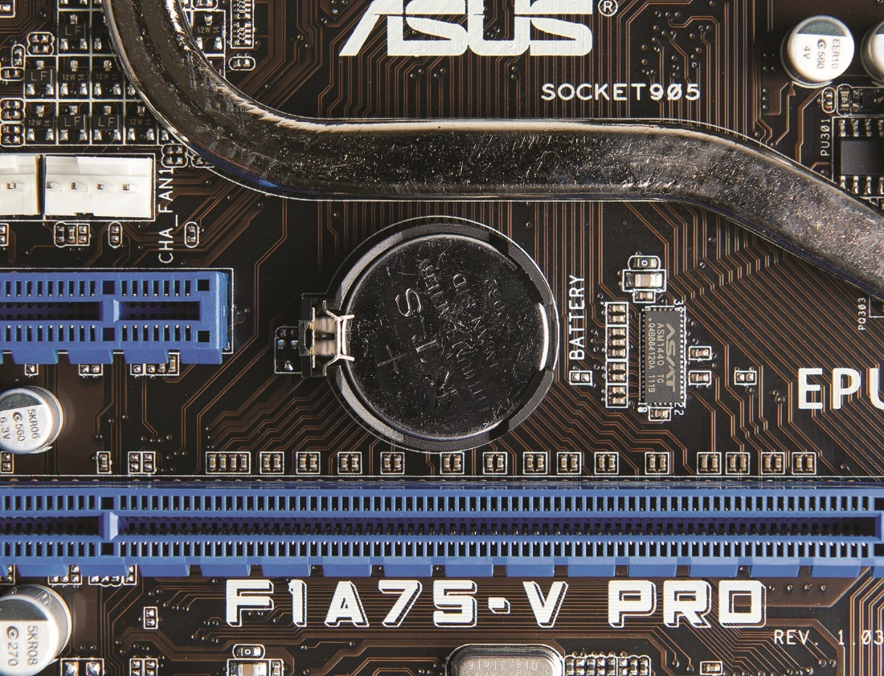
Losing CMOS Settings
Figure 6.43 A CMOS battery
Notes:
Your CMOS needs a continuous trickle charge to retain its data. Motherboards use some type of battery, usually a coin battery like those in wrist watches, to give the CMOS the charge it needs when the computer is turned off (see Figure 6.43). This battery also keeps track of the date and time when the PC is turned off.

Slide 66
Losing CMOS Settings
Common reasons for losing CMOS data:
Pulling and inserting cards
Touching the motherboard
Dropping something on the motherboard
Dirt on the motherboard
Faulty power supplies
Electrical surges
If clock keeps resetting, replace the motherboard battery.
While keeping PC plugged into an AC outlet

Slide 67
Flashing the ROM
Flash ROM chips can be reprogrammed.
Called a firmware upgrade
Download the program from the manufacturer and follow instructions.
Typically insert a removable disk of some sort (usually a USB thumb drive) containing an updated BIOS file.
Only flash the BIOS if necessary.

Slide 68
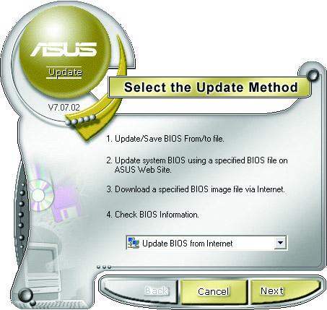
Flashing the ROM
Figure 6.44 ROM-updating program for an ASUS motherboard

Slide 69
Questions?

Slide 70
Summary
Explain the function of BIOS
Distinguish among various CMOS setup utility options
Describe option ROM and device drivers
Troubleshoot the power-on self test (POST)
Maintain BIOS and CMOS properly

Slide 71


